Slide 1
Programming 4 - Intermediate Architecture
and Algorithms
Exam Preparation
Semester 1, 2019
Notes:
Overview
Pointers
Linked Lists
Prolog
Inheritance
Finite State Machine (FSM)
Optimization
List comprehensions
Lambda
Iterators and generators
Exceptions
Ruby

Slide 2
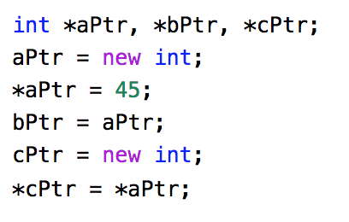
Pointers
What are the values of aPtr, bPtr, cPtr?
What are the values of *aPtr, *bPtr and *cPtr
Notes:
Pointer problems can get complicated, but the logic is always the same
What are the values of aPtr, bPtr, cPtr? => Don’t know, they are memory addresses
What are the values of *aPtr, *bPtr, *cPtr? => All 45
Don’t worry about all the operators – in practice, we don’t use them all that much in Visual C++
What is critical is that you understand that pointers don’t hold the data themselves, they hold the address of the data
Keep clear the difference between the value of a pointer (the address it holds) and the value of the data it points to (what you get when you deference)
When you declare a class instance in C# or Java, the variable is a pointer to the class instance, not the class instance itself. The language allows us to talk to the pointer as though it was the instance. For example, Person John; John->Move(). We think that John is a Person and telling John to move. Actually, John is a pointer to a Person in memory. John ho

Slide 3
Linked Lists
Pointers

Slide 4
Prolog
Pointers

Slide 5
Inheritance
Pointers

Slide 6
Finite State Machine (FSM)
Pointers

Slide 7
Optimization
Pointers

Slide 8
List comprehensions
Pointers

Slide 9
Lambda
Pointers

Slide 10
Iterators and generators
Pointers

Slide 11
Exceptions
Pointers

Slide 12
Ruby
Pointers

